Slide 1

School of Computer Science Engineering & Information Systems
Department of Software and Systems Engineering
M.Tech Software Engineering
SWE3099-Industrial Internship
Name :Vikash Chand reg.no:20MIS0210
Project:Bulk Email Marketing WebApp

Slide 2
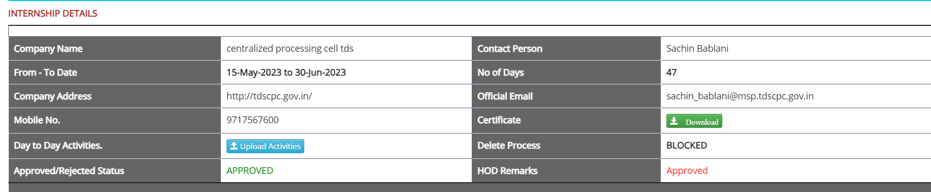
Period of training : From 15th May 2023 To 30th June 2023
Name of internal guide : Ms. Kalaivani s
Name of external guide :Sachin Bablani
Contact Details : 97175 67600
Name of the industry : Centralized Processing cell TDS
Company Address : CPC(TDS), Aayakar Bhawan,
Sector - 3, Vaishali, Ghaziabad, UP

Slide 3
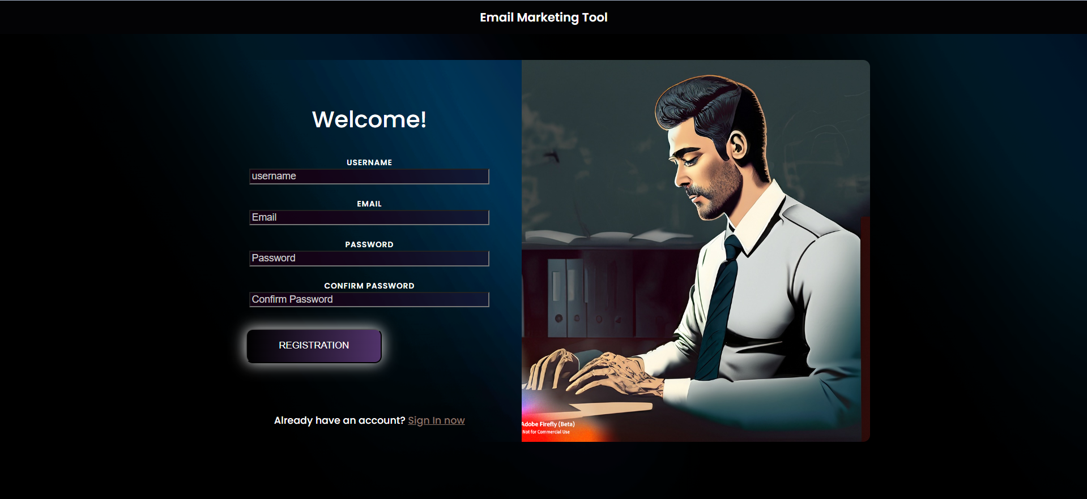
Bulk Email Marketing Webapp

Slide 4
" Bulk Email Marketing Software: Addressing Key Challenges in Digital Marketing
Challenges:
1. Lack of streamlined, user-friendly email marketing platforms.
2. Incomplete features leading to time-consuming processes.
3. Limited campaign performance insights for optimization.
4. Rising security concerns in an era of cybersecurity threats.
5. Compatibility and accessibility issues across devices.
6. Difficulty in scaling email campaigns for a growing customer base.
Solution:
Email Bulk Marketing Software:
- Comprehensive and user-friendly.
- Secure user authentication and data protection.
- Enhanced insights for campaign optimization.
- Improved compatibility and accessibility.
- Scalability for efficient communication and growth opportunities."

Slide 5
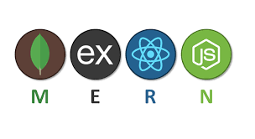





Technology used
MERN STACK
VERCEL
GIT and Github
NPM
VSCODE
JSONWEBTOKEN

Slide 6
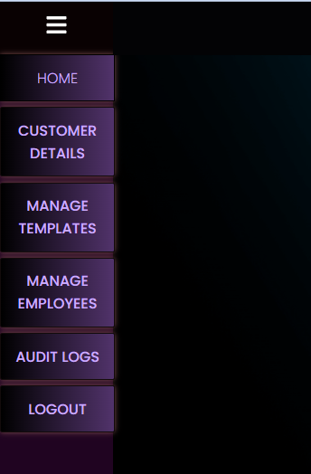
Features in webapp
Authorization and Authentication
Otp and reset password verification
Log controls
Email marketing
Employees management
Email template Management
Report generation

Slide 7
an Email marketing tool
✉️ With my software, you can effortlessly manage your email campaigns, reaching your target audience effectively and driving tangible results. Here's what sets it apart:
📋 Customer Database Management: Seamlessly upload an Excel sheet containing your customer list, complete with essential details such as email addresses and specific mail types to be sent.
📊 Comprehensive Reporting: Generate detailed reports on the success or undelivered status of your emails, allowing you to identify trends and take appropriate action. The reports are customizable based on a specified date range, giving you valuable insights.
🔒 Admin Control: As the admin, you have special privileges. You can remove users, block them if necessary, create new templates, edit or delete existing ones, and view them for further optimization. Additionally, the system keeps a comprehensive log of user activities, enabling you to monitor who did what and when.
🔐 Password Reset and Verification: Users can easily reset their login passwords through the system, and an email with a token verification system ensures enhanced security.
📱 Responsive Web App: Enjoy the flexibility of accessing my software on small devices as well. The web application is designed to be responsive, providing a seamless experience across various screen sizes.

Slide 8
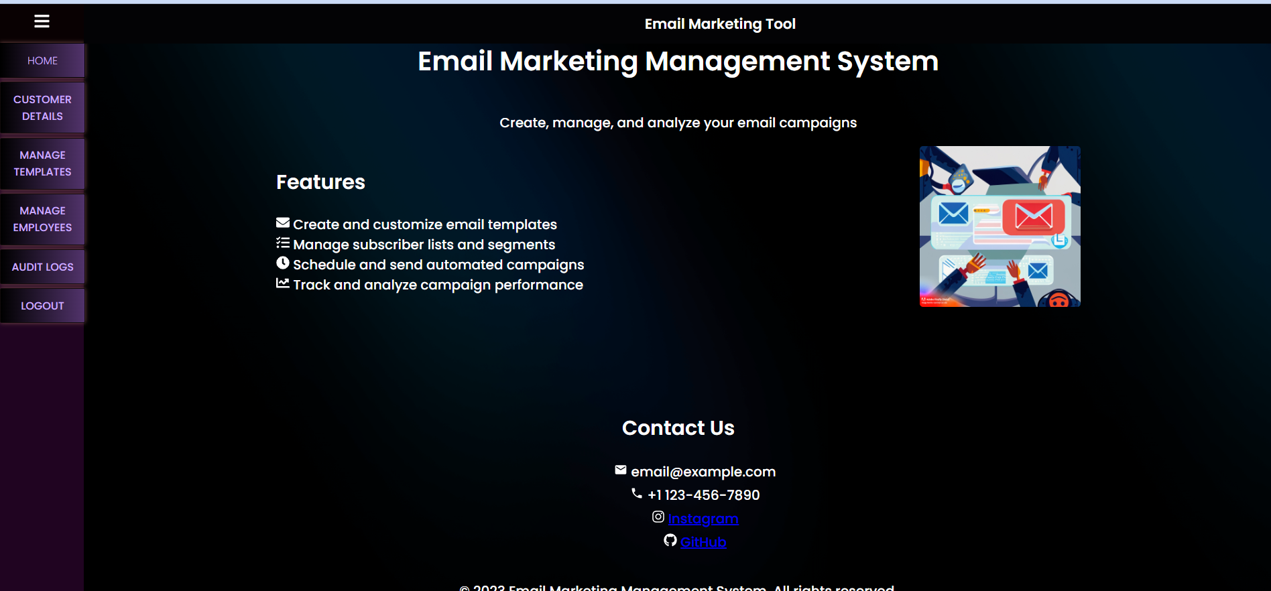

Slide 9
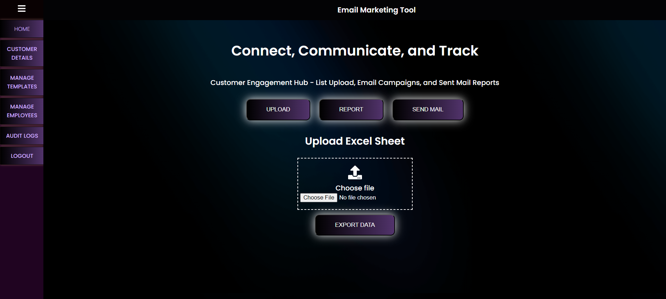

Slide 10
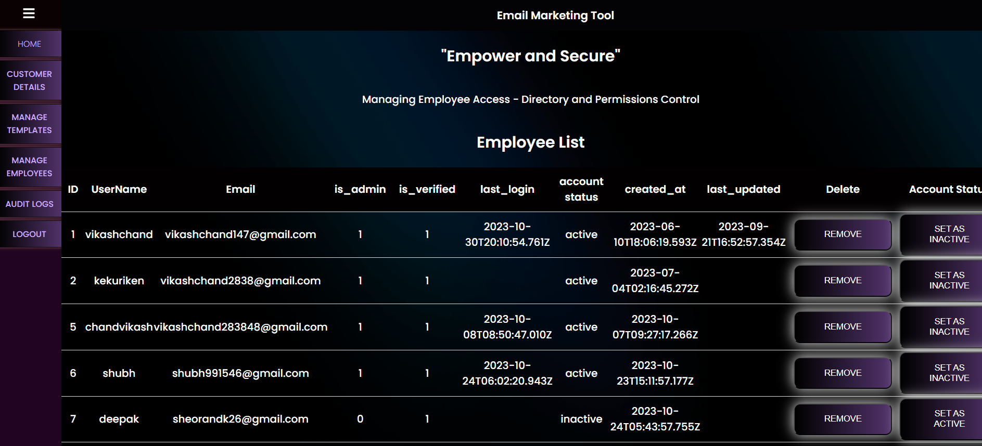

Slide 11
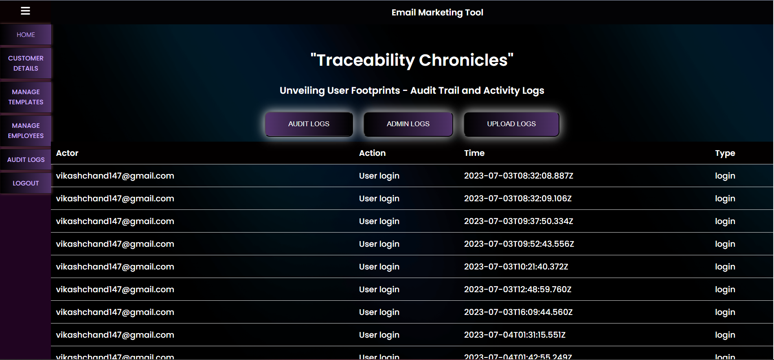

Slide 12
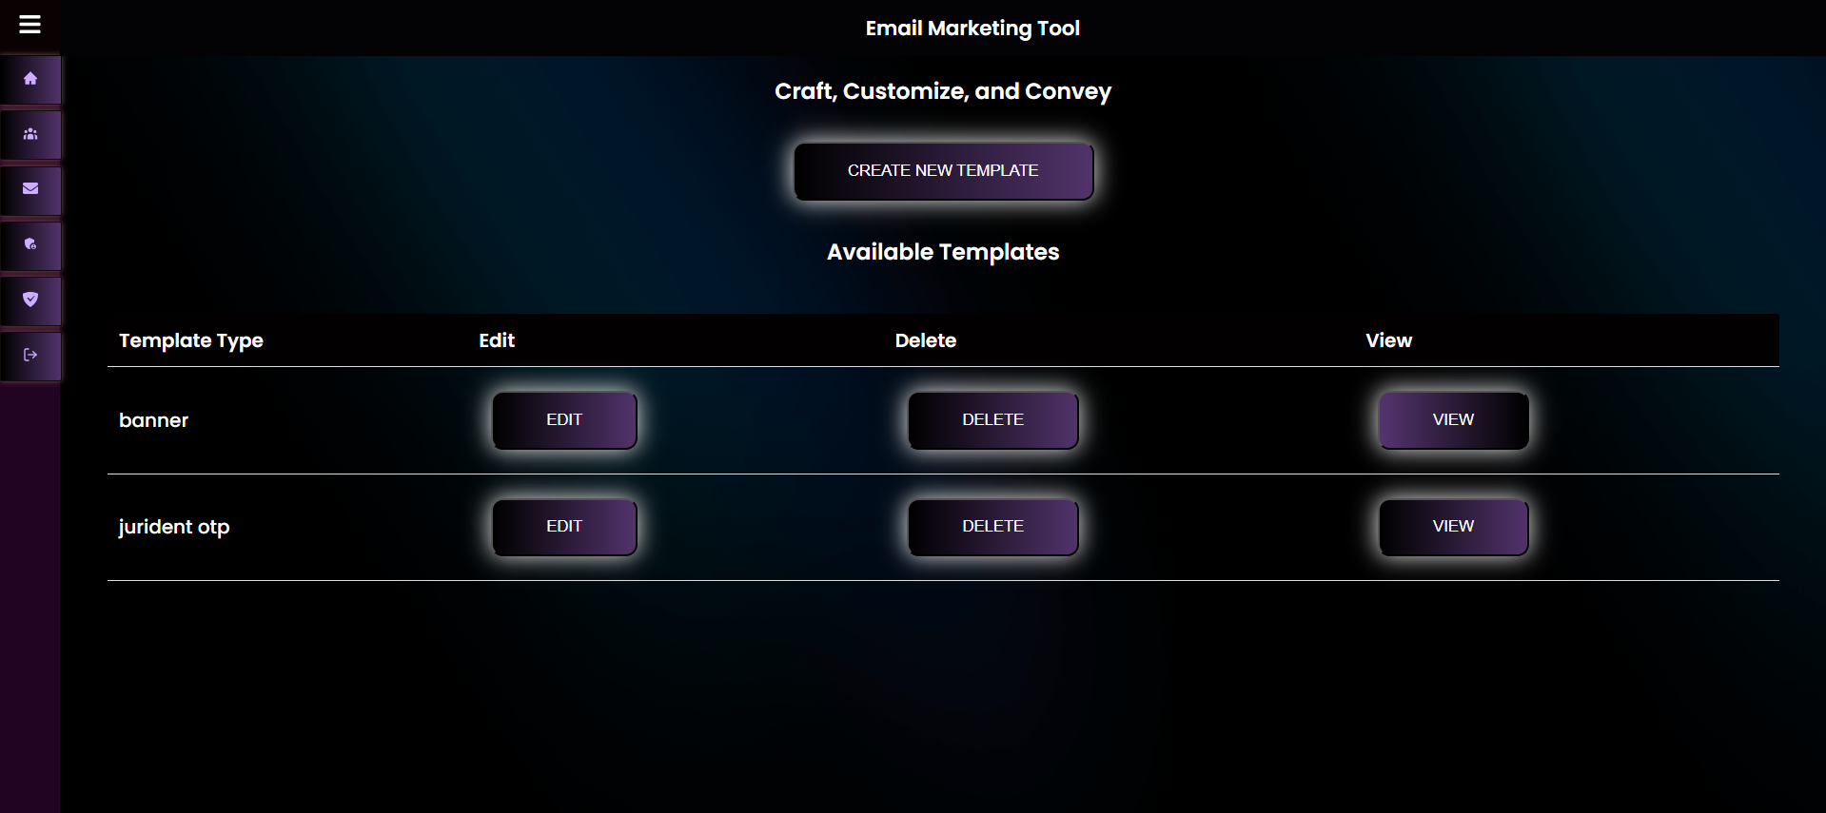

Slide 13
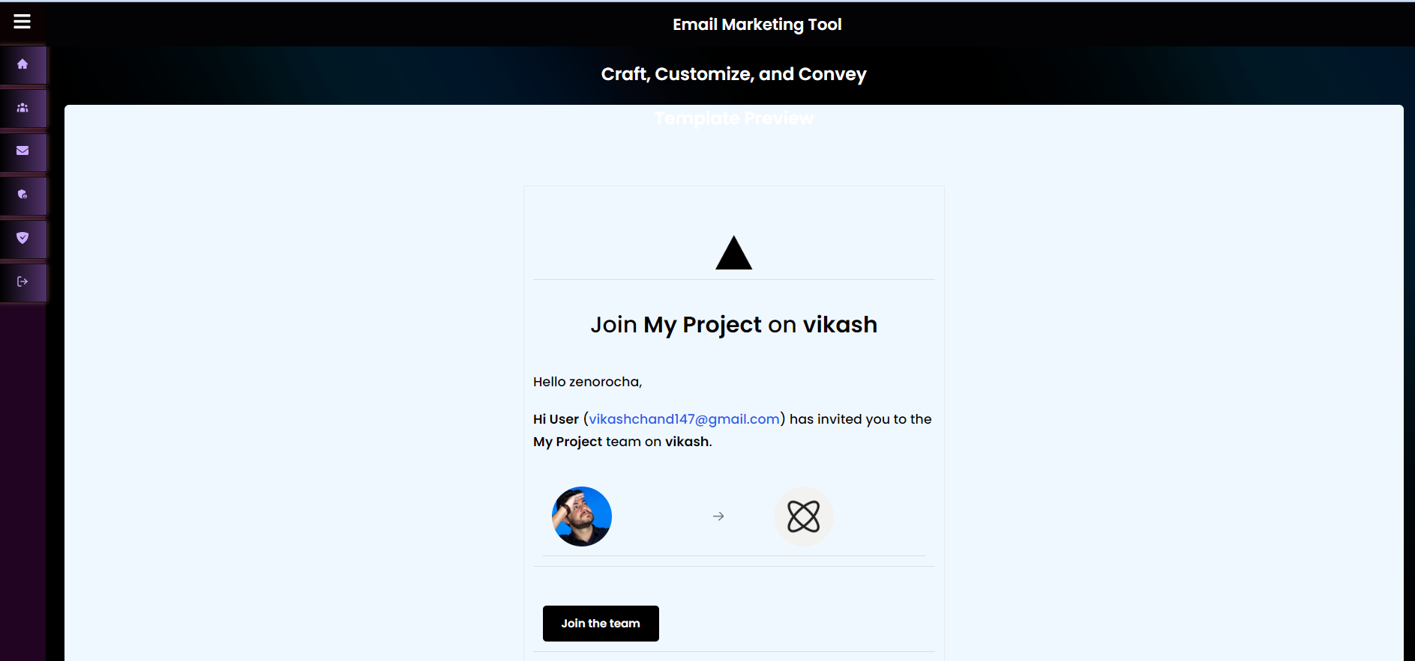

Slide 14
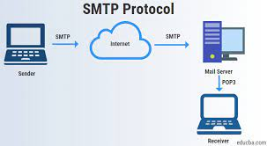
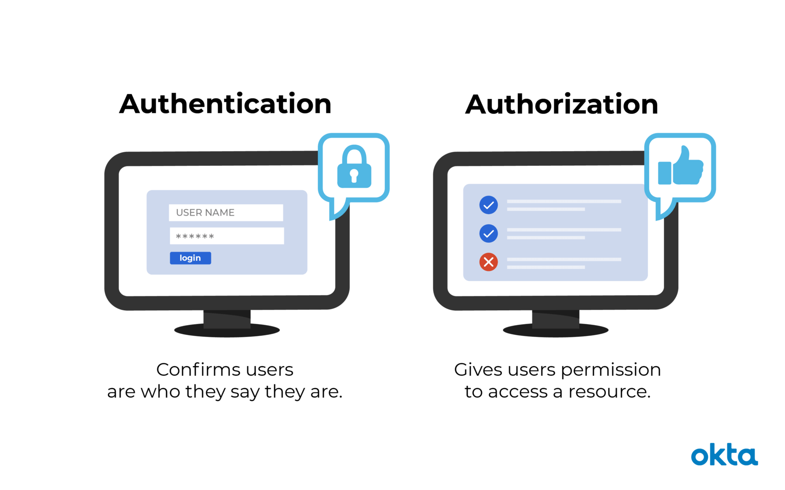


Technology Learnt
Log auditing
Authorization
Smtp
Ui/UX

Slide 15
Project live demo Link:-https://email-marketing-software.vercel.app/
Github link:-https://github.com/vikashchand/Email-Marketing-software

